Slide 1
Movie Theater
Jiawei Li
Qiaomin Ling
Notes:
Good evening everyone. I am Jiawei Li. My partner is Qiaomin Ling.Our project is to implement a movie theater that has basic function

Slide 2
Goals
Building a Reactive Application
Handling ticket sale for more than 2000 concurrent customers
Collecting recent movie-related data from twitter and making sentiment analysis to classify tweets ranging from 0(very negative) to 4(very positive) in real time
Notes:
Here are our goals. Build a Reative application, handle ticket sale for high concurrency which is more than 2000 customerswe are collecting movie-related tweets and doing sentiment analysis on them. 4 indicate the tweet is very positive and 0 is very negative.

Slide 3

Use Case
Look up
Order
Browse Movie show time
Get Movie assessment
Buy Ticket
Notes:
Our clients can look up their order, browse movie show time, buy ticket and get the score distribution of a movie.

Slide 4
Demo

Slide 5
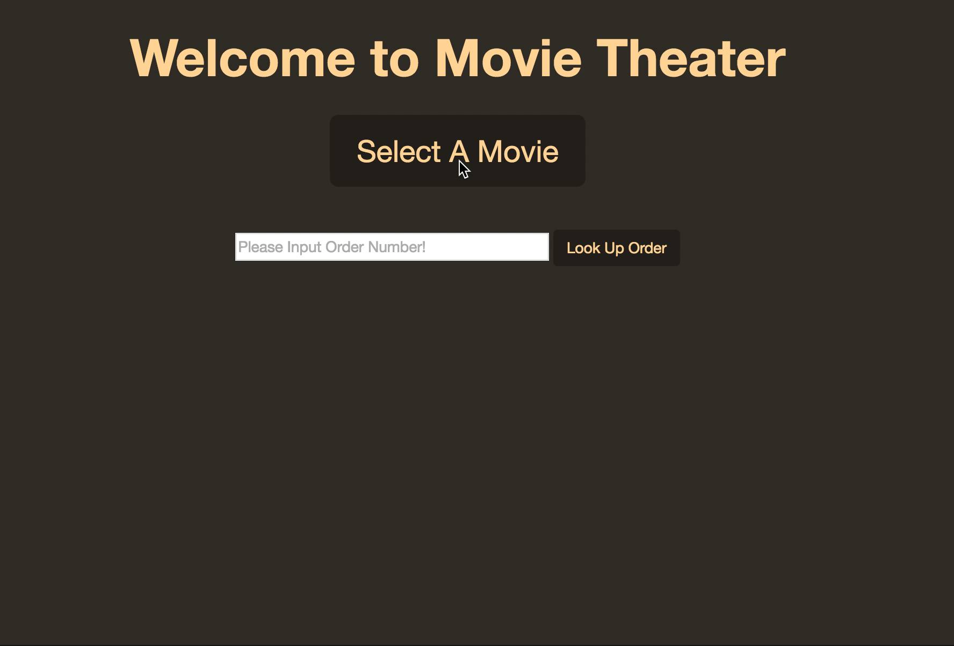
Notes:
we have recorded a short video for our web application

Slide 6
Structure
Actor System
AdminActor
StreamingActor
Pool
WebSocket
Actor
Sentiment
Actor
Consumer
Actor
Notes:
This is our application structure. Our system is based on the actor system. There is a admin actor that manage children actor and pool.
the left is our ticket scale part and the right is about sentiment analysis that we will dive into the detail later.

Slide 7
Design For Ticket Sale

Slide 8
Concepts Implemented
Load Balancing
admin actor manages a Round-Robin pool for its child, consumer actor
Pool Resizer
Supervisor Strategy(restart, stop, resume)
Functional Relational Mapping(Typesafe slick)
Non-blocking
Notes:
There are some concepts we have implemented to our application
The first one is load balancing.
admin actor manages a round-robin pool for its child. This pool means, if you have five consumer actor in the pool. The message will go to the actor one by one in turn.
furthermore, applying a Pool Resizer enables the pool to scale out or scale in.
The supervisor strategy means what parent actor will do when their children encounter a exception. restart the child or stop, or resume
we apply functional relation mapping to our database by typesafe slick. slick will return a future of result after we have some operation to database
which enables Non-blocking programming.

Slide 9
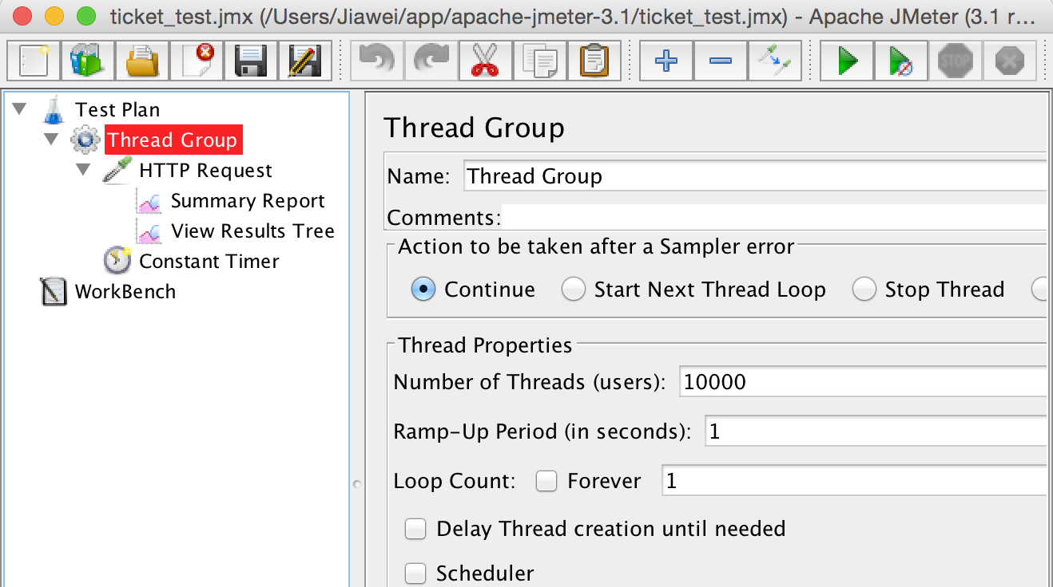
Load Test For Ticket Sale
Notes:
we have done the load test for ticket sale operation. we run a group of threads to simulate ten thousand users buying tickets with very minor error that occurs.

Slide 10
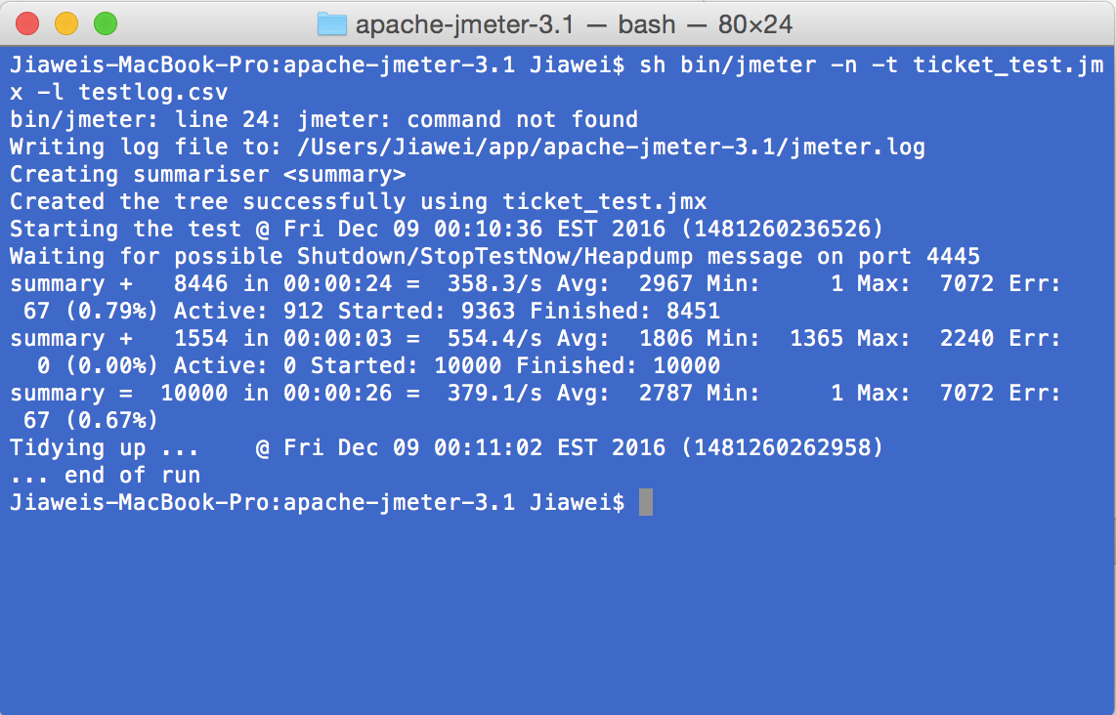
Load Test

Slide 11
Movie Tweet Analysis

Slide 12
Procedures For Our Analysis
Data Exploration
Data Preprocessing
Model Building
Model Evaluation
Tweet Sentiment Prediction

Slide 13
Data Exploration
Biased Tweet Dataset From Sentiment 140.com
1600,000 training data
training data has two labels, 0 and 4
testing data has four labels, from 0 to 4
Movie Dataset From SAR14
233,600 movie reviews
10 labels, from 1 to 10
Notes:
At the very beginning of our project, we start with a biased dataset. After we trained the model for it, we found we only have two labels. because the training set only have label 0 and 4, but testing dataset has label from 0 to 4. Then we switched to new dataset

Slide 14
Data Preprocessing
Split the data by using Spark, 90% for training, 10% for testing
Remove the links, hashtags, mentions. stop words from review
Transform the words into sparse vectors

Slide 15
Model Building
Apply Naive Bayes Algorithm
RDD-based API
DataFrame-based API

Slide 16
Model Evaluation
 | RDD-based API | DataFrame-based API | Stanford CoreNLP API
Accuracy | 60.41% | 27% | 33%
If the number of labels was reduced to 3, the accuracy for the model built by RDD-based API would be up to 88%
Save the model
Notes:
Then we evaluate our model and one thing is so weird that the accuracy by using rdd-based api is different than dataframe-based api.

Slide 17
Tweet Sentiment Prediction
Load the model From the project root path
Predict each tweet derived from Spark Streaming in real time

Slide 18
Publisher And Subscriber Pattern
connection request
Controllers
client side
StreamingActor
ActorRef
WebSocket
Actor
Sentiment
Actor
JSON data

Slide 19
Tool involved
Play Framwork
Typesafe Slick
Postgresql database
Spark Streaming
Spark MLlib
Akka Framework
D3.js

Slide 20
Acceptance Criteria
Successfully handle more than 2,000 requests .
The range of scores for evaluating movies are from 1 to 5.
Accuracy of Naive Bayes model is above 60%.

Slide 21
Thank You

